Slide 1

Behavioral Modeling
Ehsan Yazdian

Slide 2
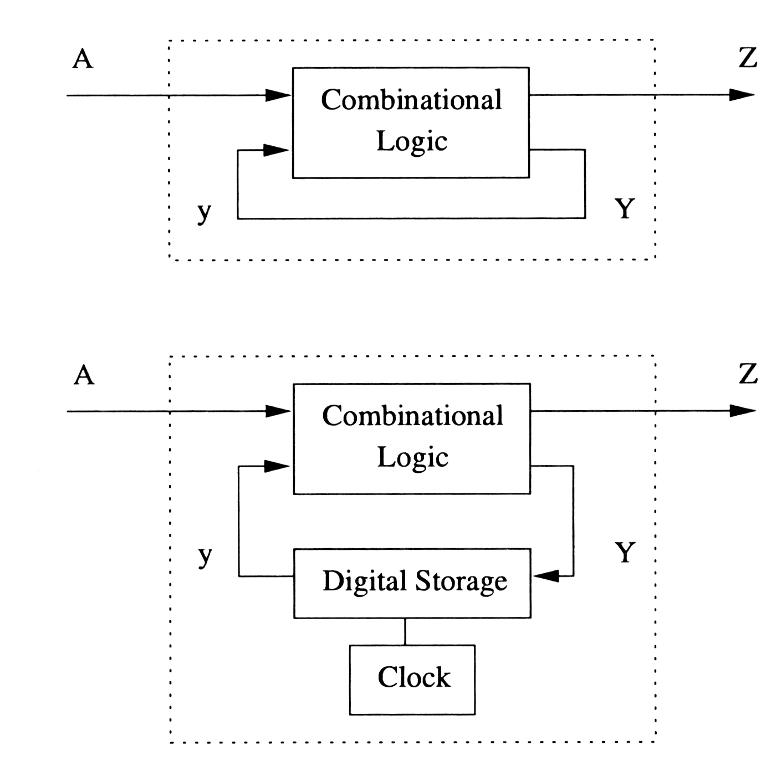
Synchronous vs. Asynchronous Circuits
Combinational logic:
The circuit outputs are a logic combination of the current inputs signals.
Sequential logic:
The circuit outputs depend on not only the current values of inputs but also previous input values.
Sequential logic = Combinational logic +Memory.
Two types of Sequential Circuit:
Synchronous: the state of the device changes only
at discrete times in response to a clock signal.
Main advantage: Simplicity.
Asynchronous the state of the device can change
at any time in response to changing inputs.
Faster and lower power consumption.
Most digital devices today use synchronous circuits. We only talk about this type in this class.
Notes:
In general, an asynchronous circuit does not need the precise timing control supported by flip-flops. It may therefore contain latches rather than flip-flops. In many cases, an asynchronous circuit simply relies on the propagation delays of its component gates and connections, combined with the circuit�s feedback structure, to implement its memory functions.
http://en.wikipedia.org/wiki/Asynchronous_circuit

Slide 3
Some Hardware Notes Sequential Logic
Clocked D LATCH
D
Q
CIRCUIT SYMBOL:
CLK
D
Q
Q
CLK
When CLK=‘1’
1 bit memory by NOR cross-loop
When CLK=1, Q = D
When CLK=0, Q holds previous data.
Verilog Code:
module D_Latch(Q, Qbar, D, Clk);
output Q, Qbar;
input D, Clk;
Wire w1,w2,Dbar;
not n1 (Dbar, D);
and a1 (w1,Dbar,Clk);
and a2 (w2,D ,Clk);
nor n1 (Q, w1 , Qbar);
nor n2 (Qbar, w2, Q);
endmodule
D
Q
Q
When CLK=‘0’
Q
Q

Slide 4
Some Hardware Notes Master-Slave D Flip-Flop
D
D
Q
D
Q
Q
CLK
CLK
CLK
CLK
D
2 LATCHES in series
Still work as 1 bit memory
CLK edge Trigger Operation
Most commonly used memory element in the state-of-the-art synchronous Digital Design.
Q only changes on the positive clock edge (once in one cycle).
Q
1
1
0
1
0
D
Q
CIRCUIT SYMBOL:

Slide 5
Some Hardware Notes
Digital Systems are just FF + CLs.
FPGA supports such digital circuit with configurability.
FPGA’s basic element
remember structure of CLBs
D
Q
D
Q
Combinational Logic
D
Q
Combinational Logic
D
Q
D
Q
Combinational Logic
Combinational Logic
D
Q

Slide 6
Behavioral Modeling
4 levels of abstraction:
Transistor
Gate Level Modeling
Dataflow Modeling
Behavioral Modeling

Slide 7
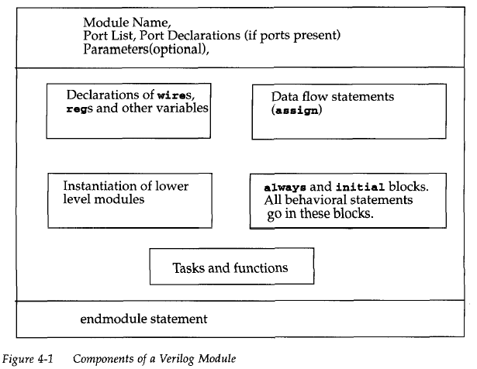
Module Structure

Slide 8
Procedural Assignment (انتساب ترتیبی)
Procedural assignments update values of reg, integer, real, or time variables.
The value placed on a variable will remain unchanged until another procedural assignment updates the variable with a different value.
Procedural assignments are done in behavioral block statements .

Slide 9
Block Types
Verilog has two types of Blocks
initial block
initial
begin : optional_name
// Procedural assignments
// These procedural assignments are executed one time at the beginning of the simulation.
end
always block
always @([sensitivity-list])
begin :optional_name
if‐else statements, case statements, while, repeat, for loops
//These procedural assignments are executed whenever the events in the sensitivity list occur.
end
module test (input clk);
reg [5:0] x, y;
integer a;
reg [8:0] z,w;
reg [15:0] v;
initial begin
x = 0;
y = 1;
end
initial #5 x = 5;
always @(posedge clk) begin
z = x+y;
a = x-y*z;
end
always @(negedge clk)
x <= z+y;
always @(x or z)
y = x*z;
endmodule

Slide 10
Procedural Assignment
The left-hand side of a procedural assignment can be one of the following:
A reg, integer, real, or time register variable or a memory element
A bit select of these variables (e.g., addr[0])
A part select of these variables (e.g., addr[31:16])
A concatenation of any of the above
All behavioural statements appear only inside these blocks
Each module may contains many of these blocks.
Each always or initial block has a separate activity flow (parallel and concurrent)
No nesting
initial begin
initial …..
……
end

Slide 11
initial Statement
The initial block is executed once when the simulation is started i.e. time=0.
Executes only once during a simulation.
Multiple initial blocks, execute in parallel.
Each finishes independently.
Mostly used in Simulations.
reg x, y, z;
reg [15:0] reg_a, reg_b;
integer count;
initial begin
x = 0; y = 1; z = 1; //scalar assignements
count = 0; //assignment to integer variables
reg_a = 16'b0;
reg_b = reg_a; //initialize variables
#15 reg_a[2] = 1'b1; //Bit select assignment with delay
#10 reg_b[15:13] = {x, y, z};
count = count + 1; //assignment to an integer
end

Slide 12
Example
module stimulus;
reg x, y, a, b, m;
initial
m= 1’b0;
initial
begin
#5 a=1’b1;
#25 b=1’b0;
end
initial
begin
#10 x=1’b0;
#25 y=1’b1;
#15 a=1’b0;
end
endmodule
Time | Statement
0 | m=0
5 | a=1
10 | x=0
30 | b=0
35 | y=1
50 | a=0

Slide 13
Initializing variables
Ordinary style, using initial block
reg clock;
initial clock = 0;
Combined declaration and initialization
reg clock = 0; // RHS must be constant
module adder (
output reg [7:0] sum = 0,
output reg c = 0,
input [7:0] a, b,
input ci);
...
endmodule

Slide 14
always block
An always block actually "loops forever“
The initiation of each loop is controlled by the sensitivity list.
The always block can be synthesized
Example: A Synthesizable Always Block
always @(posedge clock)
begin
reg1 <= in1;
reg2 <= in2 ^ in3;
reg3 <= reg1;
end
Example:
Clock Generating in Testbenches (Obviously not Synthesizable)
module clock_gen (output reg clock);
Initial clock = 1'b0; //Initialize clock at time zero
always #10 clock = ~clock; //Toggle clock every half-cycle
Endmodule
If the unit of time is “ns” then the clock frequency is: 50MHz= 1/(2*10ns)
sensitivity list

Slide 15
Procedural Assignments
Blocking Assignment (=)
Executed sequentially in the order the statements are written.
A second assignment is not started until the preceding one is complete, in the order they are specified in a sequential block
Nonblocking Assignment (<=)
Statements of the same time step, started in parallel:
Evaluate the RHS of nonblocking statements at the beginning of the time step.
Update the LHS of nonblocking statements at the end of the time step.
resemble actual hardware more than blocking assignments.
Recommended: Use Nonblocking assignments for clocked processes when writing synthesizable code.

Slide 16
Blocking and Nonblocking Assignment
Example 3
module blocking;
reg [0:7] A, B;
initial begin: init1
A=3;
#1 A = A+1;
B = A+1;
$display(“blocking: A=%b B=%b”, A, B);
A=3;
#1 A<=A+1;
B<=A+1;
#1 $display(“non-blocking : A=%b B=%b”, A, B);
end
endmodule
blocking : A= 00000100 B= 00000101
non-blocking : A= 00000100 B= 00000100

Slide 17
Race Conditions
Occurs when executing some statements in the same time-step, would give different results when the order of statement is changed.
//always blocks with blocking
always @(posedge clock)
a = b;
always @(posedge clock)
b = a;
//always blocks with nonblocking
always @(posedge clock)
a <= b;
always @(posedge clock)
b <= a;
Which one swaps a and b?
At the positive edge of clock -> read and store all right-hand-side variables.
During the write operation, the values stored in the temporary variables are assigned to the left-handside variables.

Slide 18
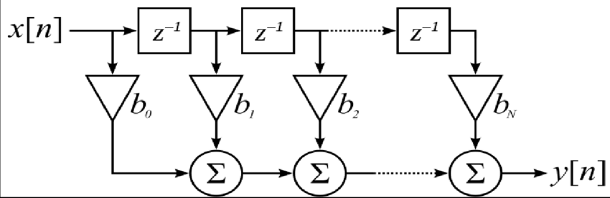
Some Simple Examples
1-bit Shift Register of length L
16-bit Shift Register of length 4:
Filter Design: A Module to calculate out from the input 8-bit sequence x: y[n]=3*x[n]+2*x[n-1]+4*x[n-3]
in
S[L]
S[L-1]
S[1]
out
clk
in[15:0]
M[4]
M[3]
M[2]
M[1]
out[15:0]
clk

Slide 19
Example Design
View the results of the post place and rout simulation model of the synchronous counter.
Comparing the results for different clock frequencies.
Argue the unknown values in high frequency values.
Describing the effects of the real delays in the hardware.

Slide 20
Conditional Statements
The same as if-else in C
Syntax:
if (<expression>)
true_statement1;
else if (<expression>)
true_statement2;
else if (<expression>)
true_statement3;
else
default_statement;
True is 1
False is 0 or x or z
More than one statement: begin end

Slide 21
Multiway Branching
Syntax:
case (<expression>)
alternative1: statement1;
alternative2: statement2;
...
default:default_statement; // optional
endcase
Default statement is optional
The case statements compare bit-for-bit
x and z values should match

Slide 22
Example Synchronous Multiplexer
module sync_mux (
input clk,
input [1:0] sel,
input [3:0] x1,x2,x3,x4,
output reg [3:0] y);
always @(posedge clk)
case(sel)
2’b00: begin
y<=x1;
end
2’b01: y<=x2;
2’b10: y<=x3;
2’b11: y<=x4;
2’bx0, 2’bx1, 2’bxx, 2’b0x, 2’b1x : y<=4’bx;
default: $display(“Unspecified control signals”);
endcase
endmodule

Slide 23
Multiway Branching: casex, casez
casez treats all z values as “don’t care”
casex treats all x and z values as “don’t care”
Example: finding the most significant 1 in a 6 bit number
reg [5:0] a;
reg [2:0] index;
always @(a)
casex (a)
6'b1xxxxx : index = 6;
6'b01xxxx : index = 5;
6'b001xxx : index = 4;
6'b0001xx : index = 3;
6'b00001x : index = 2;
6'b000001 : index = 1;
6'b000000 : index = 0;
endcase

Slide 24
Example Design
Designing a sequence detector (allowing overlap):
Detecting 101101, 11000, 01010
Each time one of these sequences is detected the 1-bit outputs “seq1”, “seq2” and “seq3” should become 1 for one clock cycle.
The module should have a “reset” signal to set the internal shift register to zero.
Write a testbench to test the module
Example:
….10001010111010101001100010101101100011……..

Slide 25
Timing Control
The time at which procedural statements will get executed shall be specified using timing controls.
Why we should use timing control?
Advance in simulation time
Three types of timing control
Event based
Delay based
Level-sensitive

Slide 26
Event-Based Timing
Change in the value of a register or net
Symbol @(<event>)
Events to specify:
Signal
Any change in signal value
Edge Sensitive
Positive edge of a signal
Change of signal from any value to 1 or from 0 to any value
Negative edge of a signal
Change of signal from any value to 0 or from 1 to any value

Slide 27
Examples
always @(posedge Clk) // A D-FF in behavioural Level without reset
q <= d;
always @(negedge Clk) // A simple Synchronous Adder
c <= b+a;
always @(b or d) // Asynchronous Subtraction
a=b-d;
initial begin
@(a) b=c;
end
initial begin
@(posedge clk) b=c;
@(negedge clk) d=a+b;
end

Slide 28
Transition of Multiple Signals
An adder with asynchronous reset
always @( reset or a or d)
begin
if (reset) //if reset signal is high, set q to 0.
q = 1'b0;
else
q = d+a;
end
Sensitivity lists can also be specified using the "," (comma) operator instead of the "or".
When the number of input variables to a combination logic block are very large we can use @* or @(*) instead of ‘or’.
always @(a or b or c or d or e or f or g or h or p or m)
begin
out1 = a ? b+c : d+e;
out2 = f ? g+h : p+m;
end
//Instead of the above method, use @(*) symbol
always @(*)
begin
out1 = a ? b+c : d+e;
out2 = f ? g+h : p+m;
end

Slide 29
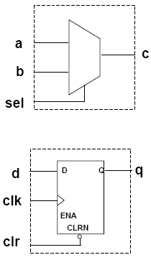
Two Types of Processes
Combinatorial process: (realized by assign and always)
Output depends on inputs
Inputs propagates to the output
Anything on the RHS should be on the sensitivity list
Example
always @(a or b or sel)
Sequential process: (realized only by always)
Output depends on inputs and circuit history
Circuit history is kept using flip-flops, registers or latches
Sensitivity list does not include the inputs, only the clock or/and control signals.
Example
always @(posedge clk or negedge clr)

Slide 30
Combinational Process
They will produce the same logical model and functionality
Check the claim in ISE.
Procedural Assignment
Continuous Assignment
reg c;
reg [3:0] sum;
always @(a or b or c_in)
{c,sum}=a+b+c_in;
wire c;
wire [3:0] sum;
assign {c,sum}=a+b+c_in;

Slide 31
Blocking Or Nonblocking assignments
The blocking and nonblocking assignments frequently confuse new Verilog users.
The basic rule of thumb is:
Use blocking assignments for a combinational circuit.
Use nonblocking assignments for a sequential circuit.
For synthesis one cannot combine level and edge changes in the same list.
For flip-flop and register synthesis the standard list contains only a clock and an optional reset.

Slide 32
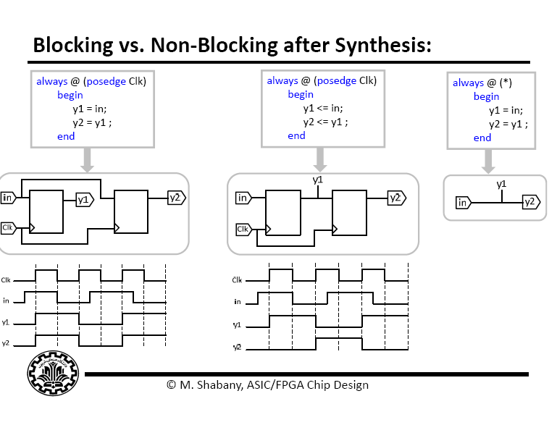
Pitfalls
Placing “=” assignments inside an always@(posedge Clock) to produce the shift register
always @(posedge clk) begin
y1 =in;
y2 =y1;
end
always @(posedge clk) begin
y1 <= in;
y2 <= y1;
end
always @(*) begin
y1 = in;
y2 = y1;
end

Slide 33
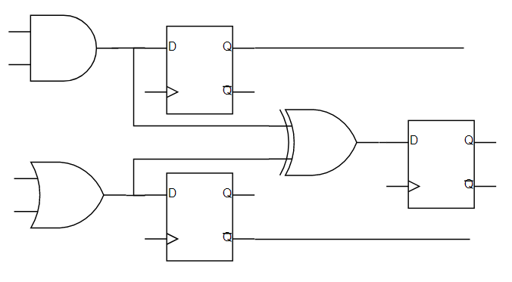
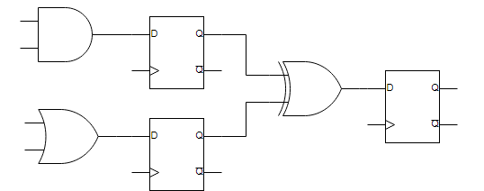
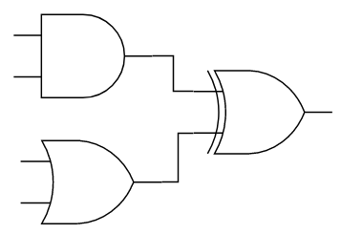
An Example
What is the difference in implementation?
module calc(
input clk,
input a,b,c,
output reg d,e,f);
always @(posedge clk) begin
d=a&b;
e=b|c;
f=d^e;
end
endmodule
module calc(
input clk,
input a,b,c,
output reg d,e,f);
always @(posedge clk) begin
d<=a&b;
e<=b|c;
f<=d^e;
end
endmodule
module calc(
input clk,
input a,b,c,
output reg d,e,f);
always @(*) begin
d=a&b;
e=b|c;
f=d^e;
end
endmodule

Slide 34
Pitfalls
Incompletely specified sensitivity lists.
Example
always @(A) begin
C = A & B;
end
An incompletely specified sensitivity list, will create an always@ block that doesn’t always set/update its elements when it should.
Synthesis tools will often know what you mean if you provide an incomplete sensitivity list, and pretend that your sensitivity list was complete.
However, this is not the case with simulation tools (like ModelSim),.

Slide 35
Clocked process with reset
An 8-bit counter with Asynchronous reset:
module counter (clk, rst, ce, out);
input clk, rst, ce; // use these as wires
output [7:0] out; // use this as a wire
reg [7:0] out;
always @(posedge clk or posedge rst) // These can cause
begin // state changes!
if (rst) out <= 8’h00; // If rst asserted, clear
else // Else rising edge clk
begin
if (ce) out <= out + 8’h01;
end
end
endmodule
Most of the time we use Synchronous Reset.

Slide 36
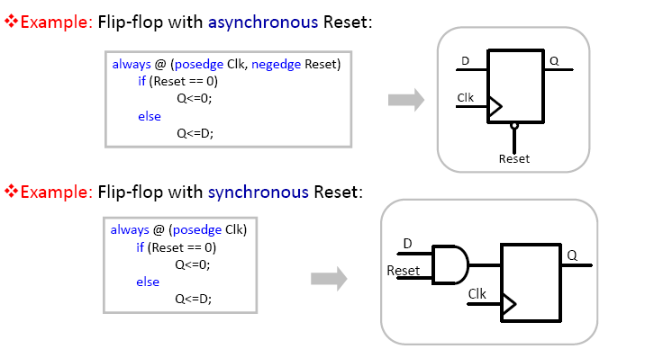
Example: Asynchronous And synchronous Reset

Slide 37
Asynchronous Reset and Asynchronous Set
Active high and Active low controls
reg q;
always @(posedge clk or posedge reset or negedge set)
if(reset)
q <= 0;
else if(!set)
q <= 1;
else
q <= d;
In some FPGAs we have FFs which has all of these inputs, thus the above code maybe implemented in a single FF.
In no FPGAs we have FFs which has more than 3 asynchronous inputs.

Slide 38
Employing Event Variables for Timing
Named Event Control
Keyword: event
event R1_changes;
always @(R1)
-> R1_changes;
always @(R1_changes)
R2 = ~R1;
Event Variables could not be synthesized but they can be used in simulations to simply design test scenarios.

Slide 39
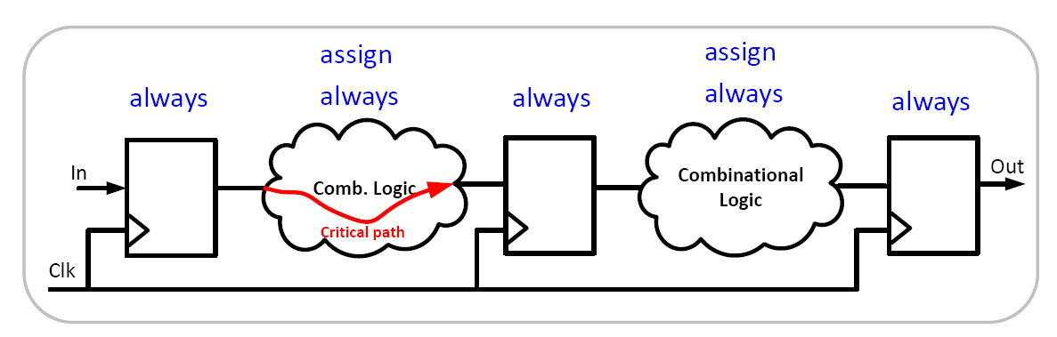
Conclusion
Use behavioural modelling for sequential logics.
Example: Combination of combinational logic and registering in behavioural coding:
Both dataflow and behavioural modelling can be employed to generate combinational logics.
assign out_wire= h1*s1+h2*s2+s3*s1;
always @(posedge clk)
out<= out_wire;
always @(posedge clk)
out<=h1*s1+h2*s2+s3*s1;
≡

Slide 40
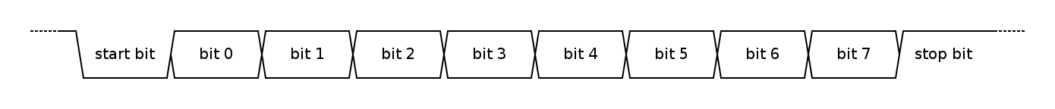
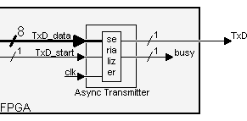
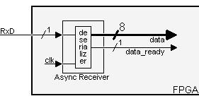
Example Design
Designing a UART Transceiver:
Universal Asynchronous Receiver-Transmitter (UART) takes bytes of data and transmits the individual bits sequentially.
Many Industrial hardware module send and receive data employing this interface due to its simple and low cost implementation without clock requirement.
Data framing
Typical Baud rates: 4800, 9600, 57600, 115200 b/s.
Structure of Module:
A Top Module
Transmitter
Receiver

Slide 41
Timing Control (Cont.)
The time at which procedural statements will get executed shall be specified using timing controls.
Why we should use timing control?
Advance in simulation time
Three types of timing control
Event based
Delay based
Level-sensitive

Slide 42
Specifying The Units of Time
timescale compiler directive
Used to define time delay unit/precision
`timescale 1ns/10ps
Time units may only be s, ms, us, ns , ps , or fs

Slide 43
Delay in Assignment
Delayed assignment
#Δt variable = expression;
#Δt variable <= expression;
Intra-assignment delay
variable = #Δt expression;
variable <= #Δt expression;
The right side is evaluated immediately but there is a delay of Δt before the result is place in the left hand assignment.
If another procedure changes a right-hand side signal during Δt, it does not affect the output.
Delays are not supported by synthesis tools.

Slide 44
Delay in Assignment
Example
reg [7:0] a=0,b=1,c=3,sum=4,z=8,h=16;
initial begin
sum[7] = b[7] ^ c[7]; // execute at t=0
z = #12 z+h;//z+h evaluated at t=0; z changed after 12 time units.
#10 h = b+c; // 10 units after z changes, b&c is evaluated.
end
initial begin
a <= #15 b+c; // b+c evaluated at t=0; a changed after 15 time units
b <= a+5; // execute at t=0
#10 h <= z+c; // execute at t=10
#15 b <= c; // execute at t=25
end
Delay specification syntax
#5
#(4, 5)
#(3, 4, 5)
#(1:2:3, 3:5:10, 4:10:12)

Slide 45
Zero-delay control : #0
Different initial/always blocks in the same simulation time
Ensures execution after all other statements
Eliminates race conditions (only in simulation)
reg a;
initial begin
#0 a = 1;
$display("Zero delay control a= %b \n",a);
end
initial begin
a = 0;
$display("Non-zero delay control a= %b \n",a);
end
Simulation Result:
Non-zero delay control a= 0
Zero delay control a= 1

Slide 46
Level-sensitive Timing Control
Level-sensitive vs. event-based
event-based: wait for triggering of a change in a signal value.
Level-sensitive: wait for a certain condition (on values/levels of signals)
Not supported for synthesis.
Keyword: wait()
initial
wait(count_enable) count=count+1;
always
wait(start) #10 go = ~go;
//The process waits until start is `1'. When the start expression is TRUE, the go signal toggles after 10 time units. The toggling statement will only stop when start returns to `0'.

Slide 47
Some Notes On Module Definition
Ports and Data Types
An input port can be driven from outside the module by a wire or a reg, but inside the module it can only drive a wire .
An output port can be driven from inside the module by a wire or a reg, but outside the module it can only drive a wire .
An inout port, on both sides of a module, may be driven by a wire, and drive a wire.
wire
wire
reg/wire
wire
wire
reg/wire

Slide 48
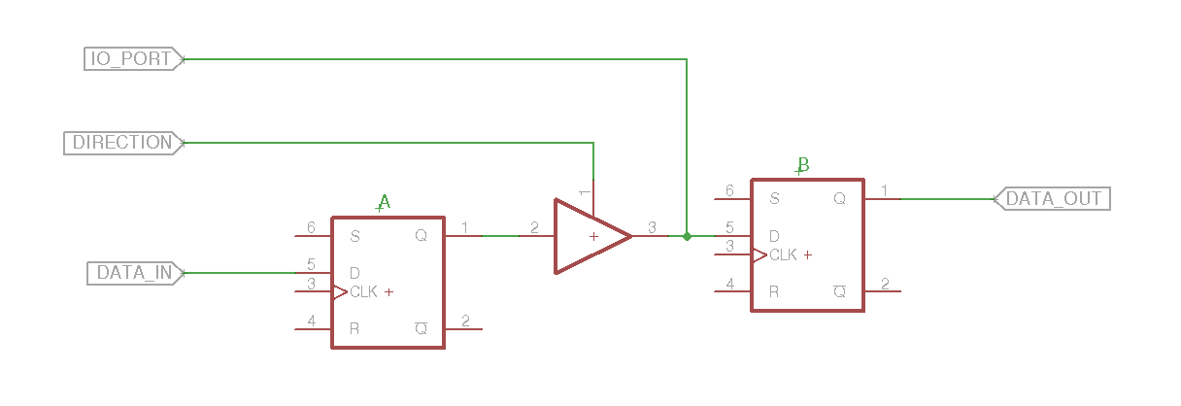
How to Work with inout Ports
You can't read and write inout port simultaneously, hence kept highZ for reading.
inout port can NEVER be of type reg.
There should be a condition at which it should be written.
Example:
module test( input clock,
input direction, // Direction of io, 1 = set output, 0 = read input
input data_in, // Data to send out when direction is 1
output data_out, // Result of input pin when direction is 0
inout io_port // The i/o port to send data through
);
reg a, b;
assign io_port = direction ? a : 1'bz;
always @ (posedge clock) begin
b <= io_port;
a <= data_in;
end
endmodule

